Slide 1

 | S.S.V.P.S’s B. S. Deore Polytechnic, Dhule Department of Computer Engineering Academic Year : 2026-2027
SEMINAR AND PROJECT INITIATION COURSE
Sem : CO 5 K |  | SPI – 315003 | Date :
Topic : AI Based Deepfake Detection
Sr. No. |  | Name of Student
1 |  | Adnan Anwarul Haque Ansari
2 |  | Vivek Umesh Gangurde
3 |  | Rohit Aanna Karve
4 |  | Bhavesh Ashok Madne

Slide 2
Contents
Certificate
Abstract
Introduction
Literature Review
Information/Chapters
Advantages and Disadvantages
Conclusion
Project Initiation :
6. 1 Description of problem statement.
6. 2 Scope and objectives.
6. 3 Stake holder
6. 4 Platform/ Equipment/ Resources identification.
Seminar Presentation
Bibliography
References

Slide 3
Abstract
Deepfakes are AI-generated or manipulated images, videos, and audio that can appear genuine to viewers, created by altering a face, expression, or voice. While synthetic media can support film production, education, and creative work, malicious use can enable impersonation, fraud, and misinformation. As generated media becomes more realistic, visual inspection alone is often insufficient to judge authenticity, making AI-based detection important for digital media verification and forensics. This seminar reviews research on Convolutional Neural Networks (CNNs), benchmark datasets, hybrid CNN-Transformer models, and graph-based detection approaches, and discusses a workflow that preprocesses media, extracts facial features, classifies frames, and aggregates predictions into a video-level estimate. Key challenges include compression, dataset bias, and poor performance on unseen manipulation types. The proposed system is intended as a screening aid, to be checked alongside reliable sources rather than treated as a final judgement.

Slide 4
1. Introduction
AI has made it possible to generate and manipulate images, videos, and audio with high realism.
Deepfakes alter or generate a face, expression, voice, or movement using machine-learning models.
Common techniques include face swapping, facial reenactment, face editing, and face synthesis.
Realistic fake media creates challenges for journalism, cybersecurity, and digital forensics.
AI-based detection analyses visual or audio patterns to separate genuine media from manipulated content.
This seminar studies detection techniques, compares research papers, and outlines a practical system workflow.

Slide 5
2. Literature Review
Sr. No. | Approach Type | Technologies Used | Dataset | Key Objective | Limitations
1 | Dataset and CNN benchmark | XceptionNet / CNN; face tracking and cropping | FaceForensics++ (about 1,000 videos; 4 manipulation methods) | Provide a public benchmark and compare detectors across several facial-manipulation methods. | Covers older manipulation methods; compression and unseen generators can reduce accuracy.
2 | Literature survey and taxonomy | Face-forensics methods; machine learning and deep learning detectors reviewed | Public face-manipulation databases reviewed | Classify manipulation types and compare available datasets and detection approaches. | Survey findings depend on the studies available at publication time; new methods may behave differently.
3 | Lightweight deep-learning detector | Meso-4 and MesoInception-4 CNNs; frame-level score aggregation | DeepFake and Face2Face video sets described by the study | Provide a relatively small and efficient detector for facial video forgeries. | Focused on two early manipulation types; visual-only detection may miss newer or audio-based fakes.

Slide 6
Sr. No. | Approach Type | Technologies Used | Dataset | Key Objective | Limitations
4 | Survey of generation and detection | Autoencoders, GANs, deep-learning and digital-forensics methods reviewed | Datasets reported throughout the surveyed studies | Summarise deepfake creation techniques, detection methods, challenges, and research trends. | No single detector is proposed; the fast-moving field requires continued review and evaluation.
5 | Systematic review of deep-learning detectors | CNNs and other deep-learning approaches reviewed | Public datasets and evaluation setups from reviewed studies | Compare detection categories, report their advantages and drawbacks, and identify research gaps. | Reported results depend on study-specific datasets and metrics; cross-dataset generalisation remains difficult.
6 | Digital-forensics survey | Image forensics, metadata analysis, transfer learning and classifiers reviewed | Deepfake detection datasets reported in the surveyed literature | Review detection methods and datasets relevant to forensic investigation and trial courts. | A model output by itself cannot establish the source, chain of custody, or legal reliability of media.

Slide 7
Sr. No. | Approach Type | Technologies Used | Dataset | Key Objective | Limitations
7 | Hybrid CNN-Transformer model | XceptionNet, EfficientNet-B4, Vision Transformer and image augmentation | FaceForensics++ and DFDC | Fuse complementary features and improve detection while reducing overfitting. | Evaluation is benchmark-based; unseen generators, new recording conditions, and compression remain concerns.
8 | Self-supervised graph-based detector | Vision Transformer, contrastive learning, graph convolution and Transformer discriminator | Multiple deepfake benchmarks with cross-dataset and corruption tests | Learn more generalisable facial features and improve robustness and interpretability. | The reported results are based on selected experiments; performance on all future manipulations is not assured.
9 | Survey of recent detection methods | Neural networks, CNNs, audio-visual methods and alternative approaches reviewed | Datasets used by the studies surveyed, including visual and audio examples | Compare recent strategies and analyse how methods and datasets affect detection. | No universal approach is established; methods and reported results vary across datasets and media types.

Slide 8
Sr. No. | Approach Type | Technologies Used | Dataset | Key Objective | Limitations
10 | Vulnerability-driven Vision Transformer | Vision Transformer with learning-based local attention to artifact-prone patches | FaceForensics++, Celeb-DF, WildDeepfake, DFD, DFDCP and DFDC | Improve generalisation and computational efficiency by focusing on local forgery cues. | Depends on visual artifacts and benchmark evaluations; future generators may leave different cues.
11 | Generation/detection survey and benchmark | VAE, GAN, diffusion-based generation and representative detection methods reviewed | Widely used benchmark datasets and metrics | Unify task definitions and evaluate representative generation and detection methods. | Benchmark results cannot cover every real-world context; fast-changing generation methods require updates.
12 | Survey of autonomous multimodal detection | CNNs, machine/deep learning, computer vision and audio-analysis methods reviewed | Studies published from 2018-2024 and their evaluation datasets | Review autonomous image, video, and audio detection methods and their evaluation. | Results across modalities and datasets are not directly interchangeable; universal robust detection remains open.

Slide 9
3. Information to seminar topic
Technology : Convolutional Neural Networks (CNNs), Vision Transformers, graph-based models
Main purpose : To estimate whether an image or video has been manipulated to produce a deepfake.
Key concept : Learning visual patterns such as texture, blending boundaries, and facial inconsistencies.
Approach : Extracts frames, detects and crops faces, classifies each sample, and aggregates scores into a video-level result.
Main benefit : Faster, consistent first-stage screening to support digital media verification and forensics.
Application : Can be applied to screening suspicious videos, journalism verification, and platform content moderation.

Slide 10
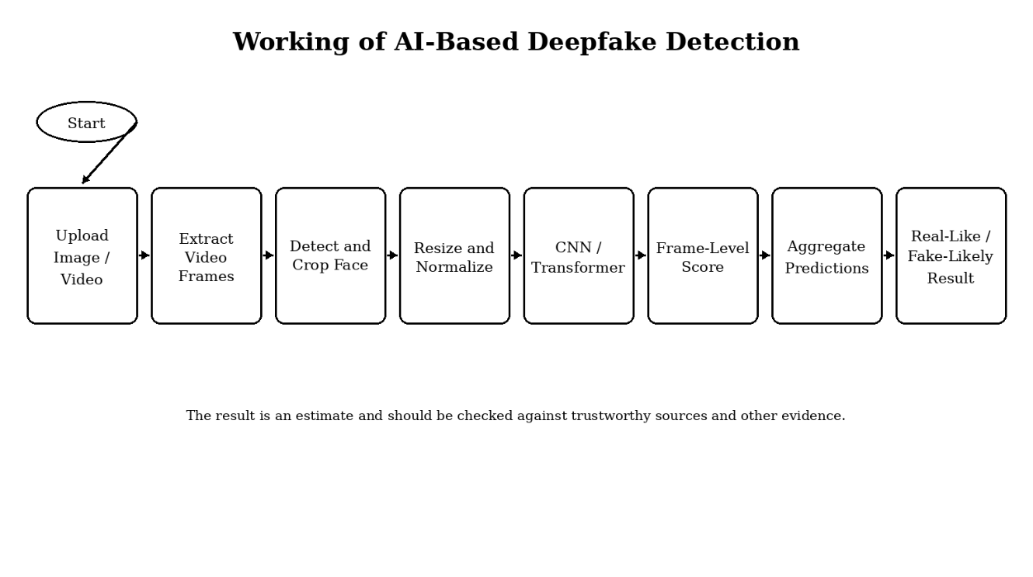
3. Working Principle
The workflow begins when a user submits an image or video for analysis.
Frames are sampled, faces are detected and cropped, then resized and normalised.
A CNN or hybrid model extracts features and classifies each sample.
Frame-level scores are aggregated into a video-level real or fake estimate.

Slide 11
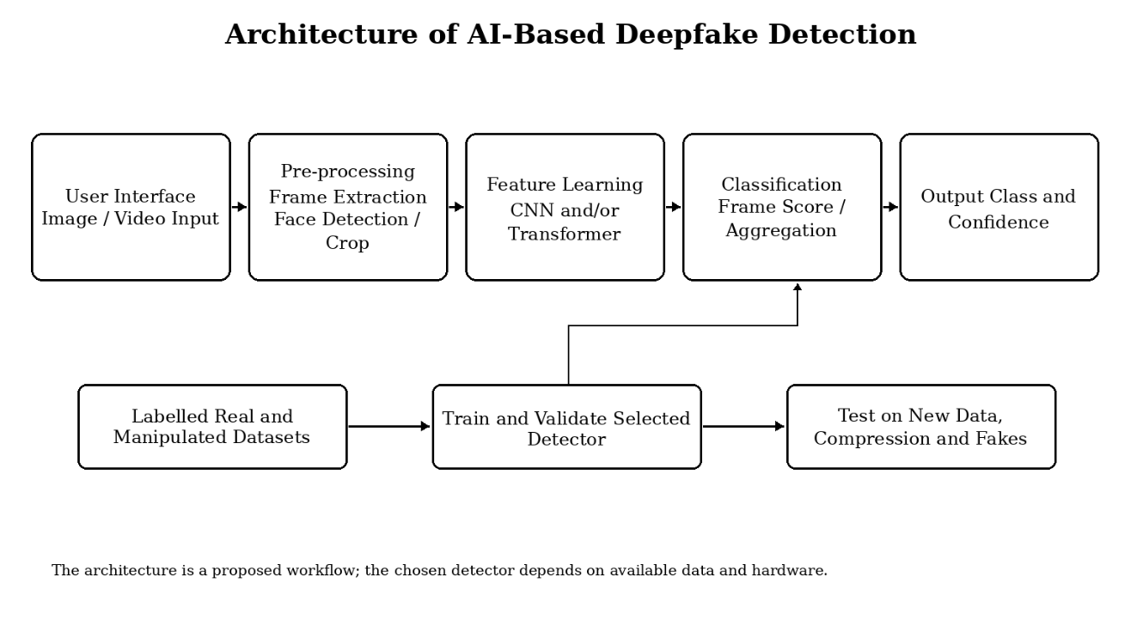
3. System Architecture
Main stages: user interface, pre-processing, feature learning, classification, and output.
The detector is trained and validated on labelled real and manipulated datasets.
Testing covers new data, compression, and unseen manipulation types.

Slide 12
4. Advantages / Disadvantages
Advantages
Faster screening: analyses many frames more quickly than manual inspection.
Consistent analysis: applies the same learned criteria to every input.
Useful for large collections: helps prioritise suspicious items for review.
Adaptable methods: CNNs, Transformers, and graph-based methods can be improved over time.
Benchmark evaluation: public datasets allow performance to be compared fairly.
Disadvantages
False predictions: genuine media can be misclassified as fake, or vice versa.
Limited generalisation: a model trained on one dataset may perform poorly on unseen generators.
Compression effects: resizing, blur, and compression can remove useful detection traces.
Computational requirements: training large models needs substantial memory and GPU resources.
Evolving technology: detection methods must be updated as generation techniques change.

Slide 13
5. Conclusion
AI-based deepfake detection is an important area of digital forensics because synthetic media can be difficult to distinguish from genuine recordings. Research has progressed from CNN-based detectors to hybrid Transformer and graph-based approaches that learn richer, more generalisable features. A practical detection workflow can preprocess media, analyse facial regions, combine frame-level predictions, and present a result for review supporting verification without replacing responsible, source-checked judgement.

Slide 14
6. Project Initiation
The AI-Based Deepfake Detection project was initiated to address the growing risk of realistic synthetic media, where a face, expression, or voice can be altered or generated using machine-learning models. Such content can mislead audiences, enable impersonation, and spread misinformation.
The project's aim is to study a system that preprocesses media, detects and analyses facial regions with a trained model, and reports an estimated result. The output is intended as a screening aid, to be checked alongside reliable sources rather than treated as a final judgement.

Slide 15
6. 1 Description of problem statement.
Recent AI advances make it possible to generate realistic images and videos or alter faces and expressions.
Such media can spread misinformation or enable impersonation and fraud, while compression makes manual inspection difficult.
Detectors can perform well on familiar datasets but may struggle with new manipulation methods or low-quality video.
A practical system should analyse supplied media, estimate the likelihood of manipulation, and communicate uncertainty clearly.

Slide 16
6. 2 Scope and objectives.
Objectives
Study deepfake types and their potential misuse.
Review CNN, Transformer, and graph-based detection approaches.
Outline media input, preprocessing, detection, and result reporting.
Evaluate performance using suitable metrics and labelled data.
Identify issues caused by compression, unseen fakes, and dataset bias.
Emphasise that model scores support, but do not replace, verification.
Scope
Accepts images or videos as input for screening.
Samples frames and prepares face crops from video input.
Runs a trained detector such as a CNN baseline.
Compares a CNN baseline with a more advanced model where resources permit.
Produces an estimated real/fake label for review.
Excludes large-scale deployment and guaranteed detection of all deepfakes.

Slide 17
6. 3 Stake holder
End Users: Individuals or organisations that want to screen suspicious images and videos before sharing or relying on them.
Developers: The team responsible for designing the interface, preprocessing pipeline, model integration, and test procedures.
Researchers: People who study media forensics, deep learning models, datasets, and evaluation methods.
Media and Fact-Checking Teams: Journalists or verification staff who may use a model result as one signal for further investigation.
Platform and Security Teams: Groups that may need to review suspicious media while considering privacy and misuse risks.
Project Guide and Evaluators: Faculty members who guide the seminar and evaluate the report, presentation, and proposed system design.

Slide 18
6. 4 Platform/ Equipment/ Resources
Hardware Requirements:
Computer or laptop for coding, testing, and running the detector.
RAM: at least 8 GB recommended; larger models may need more.
GPU (if available): helpful for training and faster inference, not mandatory for a small prototype.
Software Requirements:
Operating system: Windows or Linux.
Programming language: Python 3.11.
Deep learning framework: PyTorch or TensorFlow.
Image processing: OpenCV for frame extraction and face cropping.
Code editor: Visual Studio Code.
Other Resources:
Research datasets such as FaceForensics++ and DFDC (subject to access terms).
Internet and storage to install libraries and store model files and test media.
Testing on compressed and unseen samples where possible.

Slide 19
Bibliography
Rossler et al. (2019) - FaceForensics++: Learning to Detect Manipulated Facial Images, ICCV.
Tolosana et al. (2020) - DeepFakes and Beyond: A Survey of Face Manipulation and Fake Detection.
Afchar et al. (2018) - MesoNet: a Compact Facial Video Forgery Detection Network, WIFS.
Nguyen et al. (2021) - Deep Learning for Deepfakes Creation and Detection: A Survey.
Passos et al. (2024) - A Review of Deep Learning-based Approaches for Deepfake Content Detection.
Celebi, Liu and Karatoprak (2022) - A Survey of Deep Fake Detection for Trial Courts.

Slide 20
Bibliography (contd.)
Khan and Dang-Nguyen (2022) - Hybrid Transformer Network for Deepfake Detection.
Khormali and Yuan (2023) - Self-Supervised Graph Transformer for Deepfake Detection.
Krueger, Vanamala and Dave (2023) - Recent Advancements in the Field of Deepfake Detection.
Nguyen et al. (2024) - FakeFormer: Efficient Vulnerability-Driven Transformers for Deepfake Detection.
Pei et al. (2026) - Deepfake Generation and Detection: A Benchmark and Survey.
Sunil et al. (2025) - Exploring Autonomous Methods for Deepfake Detection: A Survey.

Slide 21
References
Research Papers
FaceForensics++: Learning to Detect Manipulated Facial Images
DeepFakes and Beyond: A Survey of Face Manipulation and Fake Detection
MesoNet: a Compact Facial Video Forgery Detection Network
Deep Learning for Deepfakes Creation and Detection: A Survey
A Review of Deep Learning-based Approaches for Deepfake Content Detection
A Survey of Deep Fake Detection for Trial Courts
Hybrid Transformer Network for Deepfake Detection
Self-Supervised Graph Transformer for Deepfake Detection
Recent Advancements in the Field of Deepfake Detection
FakeFormer: Efficient Vulnerability-Driven Transformers for Generalisable Deepfake Detection
Deepfake Generation and Detection: A Benchmark and Survey
Exploring Autonomous Methods for Deepfake Detection: A Detailed Survey on Techniques and Evaluation

Slide 22
Thank you

